Slide 1
BT201
Biochemical Process Calculations
Tutorial : purging and bypass
12/10/2022

Slide 2

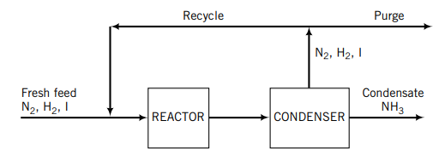


Slide 3
Tutorial: Purging

Slide 5
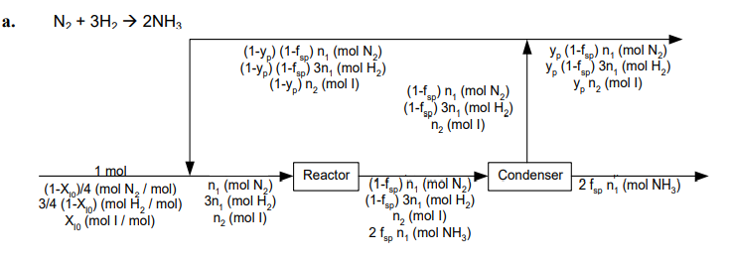


Slide 6
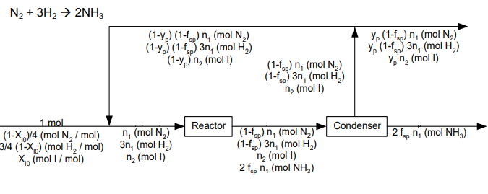


Slide 7

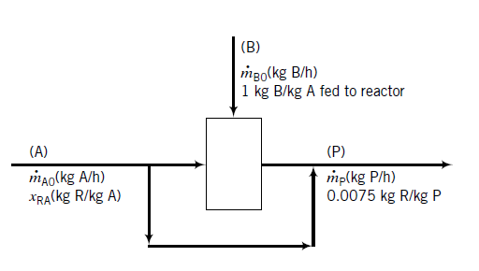
Tutorial: Bypass

Slide 8
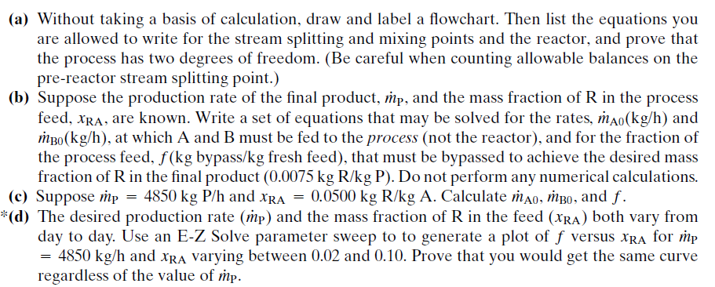

Slide 9
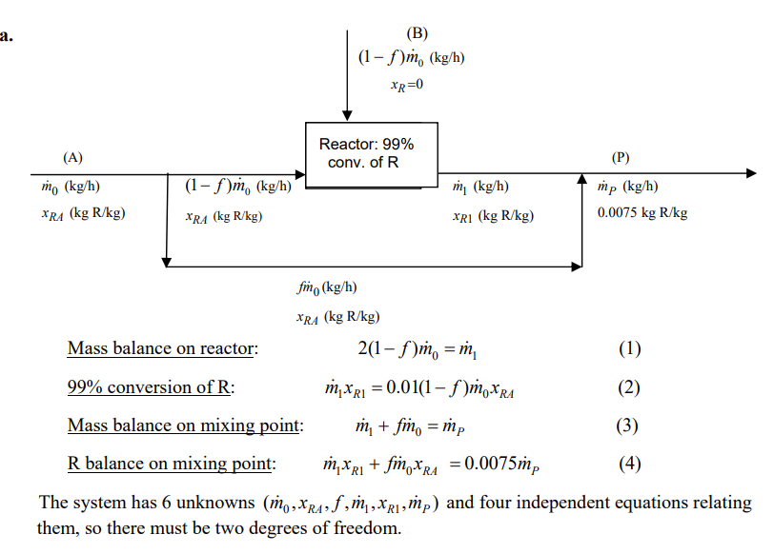

Slide 10
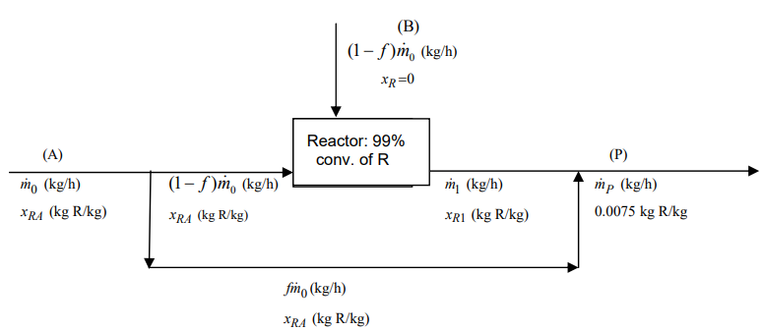


Slide 11
